Slide 1
Loan Dataset Analysis
A Comprehensive Risk Analysis

Slide 2
Introduction
Purpose of the Analysis
Brief Overview of the Loan Dataset
Objectives of the Analysis

Slide 3
Dataset Columns and Descriptions
Status : Indicates the current status of the loan.
Term: The loan term in months.
Purpose: The purpose of the loan.
Subgrade: A finer classification of the loan grade.
Home_ownership: Home ownership status (Rent, Own).
pub_rec_bankruptcies: Number of public record bankruptcies.
revol_util: Revolving credit utilization rate.

Slide 4
Data Cleaning
Removing Rows with Missing Values
Handling Blank Entries
Ensuring Data Consistency
Filter out columns with NA values and blanks.
df_cleaned = df.dropna()
df_cleaned = df_cleaned.replace("", pd.NA).dropna()

Slide 5
Columns for Risk Analysis
Identified Columns:loan_status
term
purpose
subgrade
home_ownership
pub_rec_bankruptcies
revol_util

Slide 6
Data Filtering Conditions
High revol_util (greater than 50%) is associated with an increased risk of loan default.
Term : To fetch the loan end date and compare with the last payment date.
Purpose : Bankruptcies and Home Ownership Renters have a higher occurrence of public record bankruptcies compared to homeowners.
Subgrade Analysis: Lower subgrades (e.g., D1 and below) show a higher incidence of defaults.

Slide 7
Key Findings
High revol_util (> 50%) is associated with higher default risk.
Lower subgrades (e.g., D1 and below) show a higher incidence of defaults.
Renters have a higher occurrence of public record bankruptcies compared to homeowners.

Slide 8
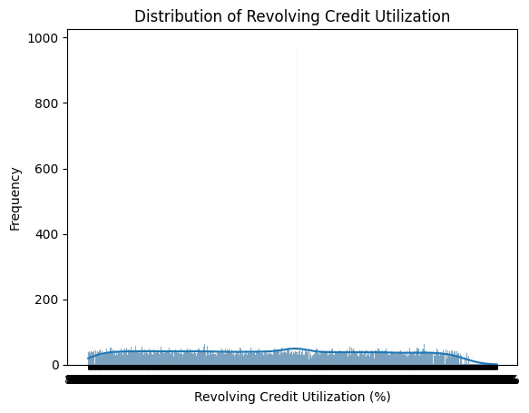
Visualization - Revolving Credit Utilization

Slide 9
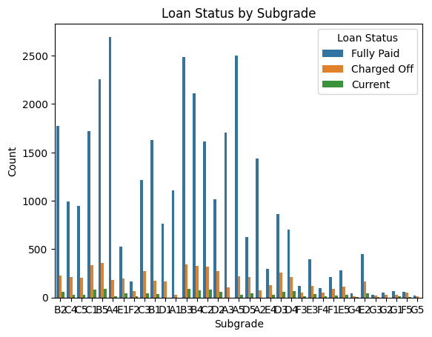
Visualization - Loan Status by Subgrade

Slide 10
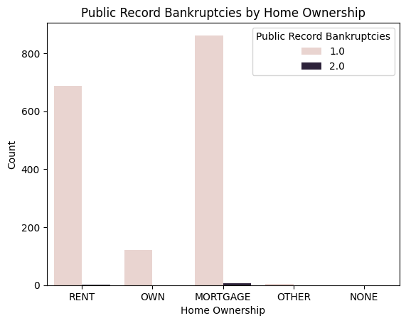
Visualization - Bankruptcies by Home Ownership

Slide 11
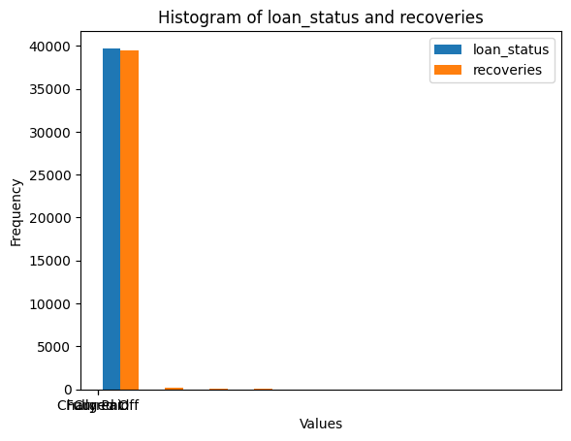
Loan status and recoveries

